Slide 1
ACADEMIC WRITING AND LITERATURE REVIEW REVISION
By Miss Linda Mkaza

Slide 2

What is a Literature Review?

Slide 3
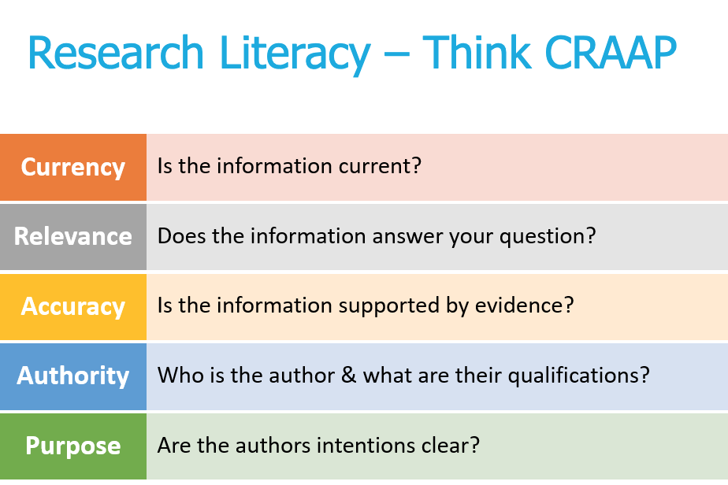
Review the literature
The collected body of work related to a topic
Books and articles published in an academic journal
You need previously published worked related to your topic (CRAAP test)
Gather ideas or information related to the topic
Keep up with current trends or major findings
Summarize previous research related to the topic and show how it's related to her own topic.
Previous scholar research on the topic

Slide 4

The Dinner Party

Slide 5
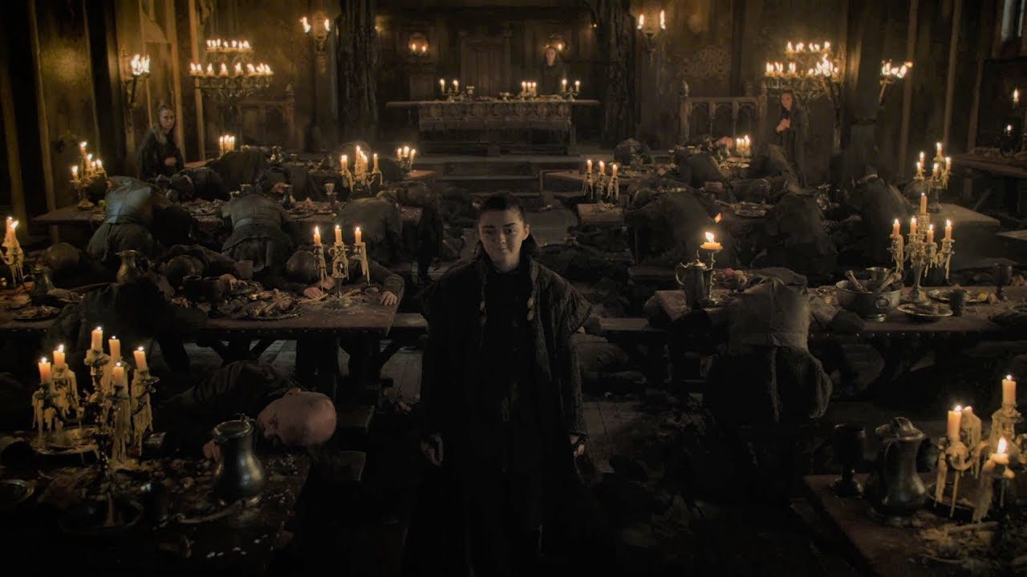
Your party, your rules
You, as the writer are the host, and other scholars ate your guests
You decide who to invite to the table and who to leave out
You place the name of your guests close to you and some further from you, depending on their relevance to your study
You decide how long you will have a chat with particular guests and how much time you will devote to them
There is no right or wrong way to host your party, you are, after all the host.

Slide 6
Are guests in agreement?
Author | Year | Theme | Definition | In-text Reference
Lewis | 2017 | Social Media | Social media has negative effects on individuals | (Lewis, 2017)
Ruth | 2018 | Social Media | Social media leads to people having a bad self-image | (Ruth, 2018: 52)
Delton | 2015 | Social Media | Social media has shown to have a very positive impact on communication between employees | (Delton, 2015: 6)

Slide 7
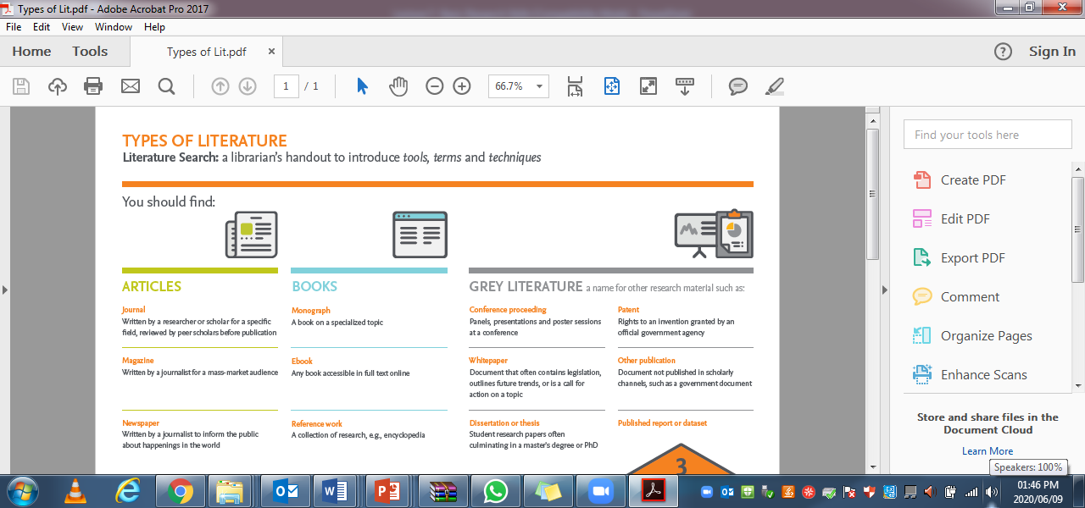

Slide 8
Primary vs Secondary research
Primary Data
Secondary data
Research that is conducted for the first time and by yourself.
It includes tools from qualitative/quantitative research methods interviews, surveys or questionnaires
Questions for primary research: you can either use open-ended or closed-ended questions
Categories of questions: Classification, interrogative, opinion, motivation
Methods
Research done by others
Secondary sources
Books, journals, encyclopedia
Literature

Slide 9
Integrating research material
Use the material to support your arguments, making sure your ideas flow coherently and cohesively.
Use the relevant material to support the main idea in each paragraph.
Use the information as accurately as possible

Slide 10

How to write your literature review

Slide 11
Academic writing
Unity
Support
Coherence
Sentence skills

Slide 12

What do these four principles mean?
Start with a clearly stated point.
Provide logical, detailed support for your point.
Organize and connect your supporting evidence.
Revise and edit so that your sentences are effective and error-free.

Slide 13
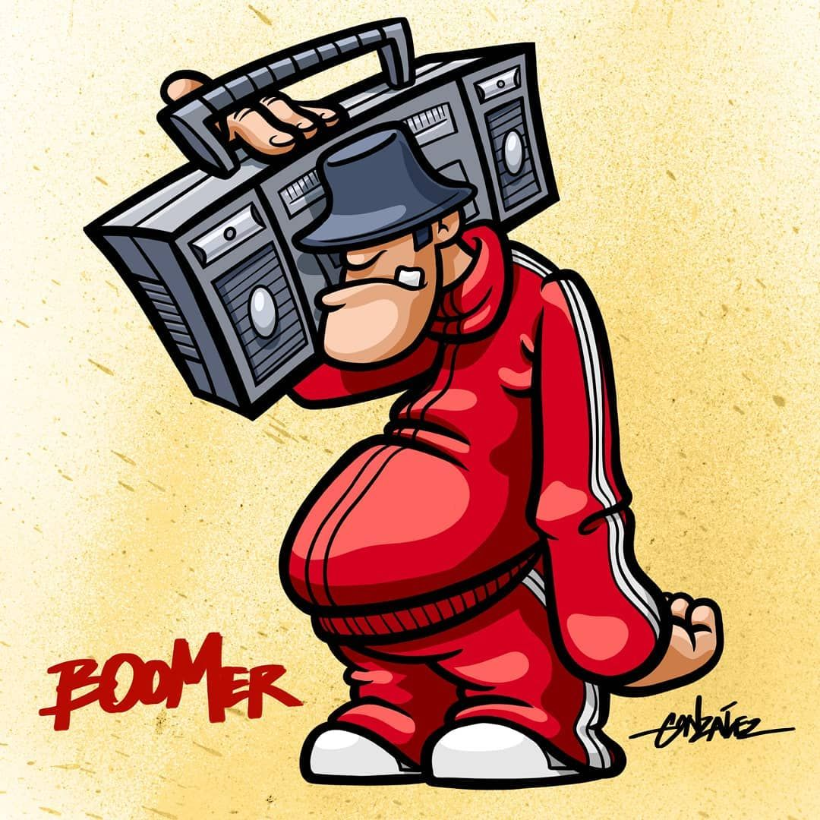
Old School
Introduction
Body
Conclusion

Slide 14

Introduction
Introduce the section or chapter
Illustrate what will be covered in the literature review section
Include the main sub-headings you will deal with in your literature review.
You will also mention the theoretical framework your study uses.
You should not include supporting details

Slide 15

Body
Review the literature
Talk to your guests and let them talk to each other
Have sub-headings you explore
Include a theoretical framework for your study

Slide 16
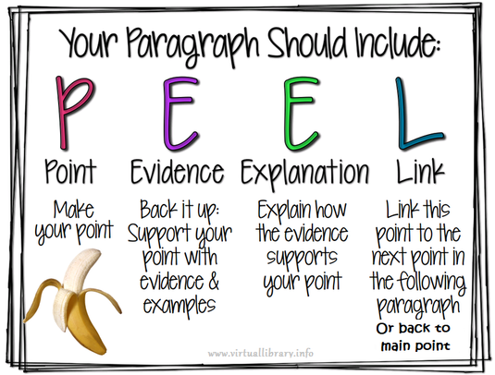
Writing the body
A well-constructed paragraph has the following characteristics:
Unity (ONE main idea)
Effective development of the main idea
Coherence (linking between sentences)

Slide 17
Paragraph development
Topic sentence (with its controlling idea) must be fully developed or explained.
Explanation takes form of supporting statements or sentences – must all relate to controlling idea expressed in topic sentence.

Slide 18
Paragraph development
By giving details or reasons.
The topic sentence is supported by supplying facts.
By giving illustrations or examples.
Main idea made concrete by means of examples.
By dividing & classifying.
Topic is divided into its constituent parts.
By comparing & contrasting.
Concepts or items are compared.

Slide 19
To be continued…
By giving causes and effects.
The reason(s) giving rise to the result(s) is (are) given.
By answering the question posed in the topic sentence (mainly used in academic writing).
Answer can take the form of any of the methods described above.
ONE paragraph is sufficient for shorter main points.
More complex issues will need to be dealt with over 2 or more par.
NOTE: Paragraphs do not always follow a single method of development – writers sometimes prefer to use a combination of 2 or even 3 methods.

Slide 20
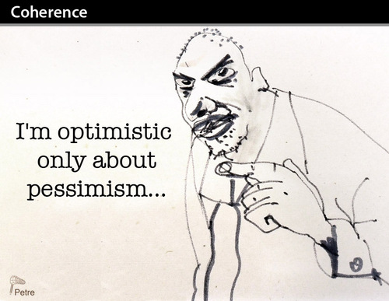
Coherence
A paragraph is coherent when its:
sentences are arranged in such a way that their relationship to one another and to the topic sentence is clear to the reader.
Coherence can be achieved by adopting the following strategies:
Arrange your sentences in the sequence that best communicates the message to the reader.
Possibilities to consider are to use descending or ascending order of importance.

Slide 21

Coherence
A paragraph functions as a unit within a larger piece of writing. A good writer uses transitions between paragraphs in order to ensure cohesion: thoughts flow smoothly from one par to another.

Slide 22
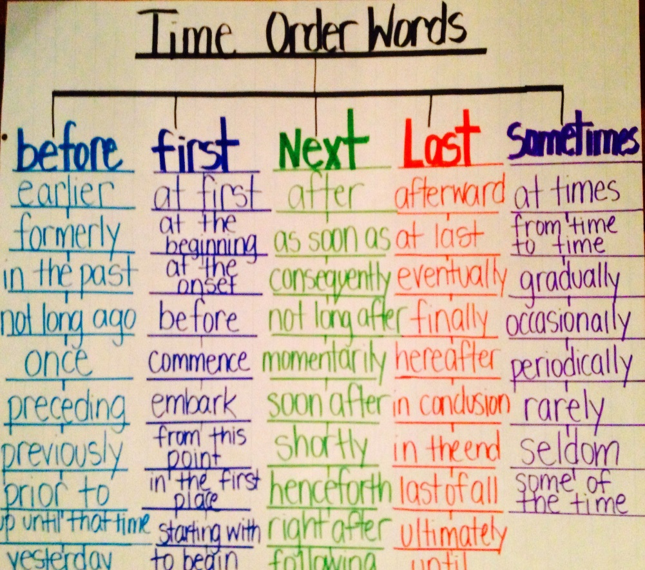
Organising and connecting
Common methods for organizing and
connecting evidence:
Time order: list details as they occur (first, next, then, after etc.).
Emphatic order: Save-the- best-till- last (Finally, most importantly).

Slide 23
To be continued
Transition words (link or signpost words that guide your reader through the text by providing clear signals):
Addition words - One, first of all, to begin with, second, also etc.
Time words - Before, first, second, third, next, later, when, while etc.
Others - For example, as a result, but, however, in contrast, in conclusion etc.

Slide 24
To be continued
To show exception: Yet, still, nevertheless, despite of, in spite of etc.
To indicate time: Immediately, thereafter, soon, then, later etc.
To emphasize: Obviously, definitely, extremely, in fact, indeed, naturally, undeniably etc.
To show sequence: first, firstly, secondly, thirdly next, finally etc.
To give example: for example, instance, to illustrate, as an example
To summarize: In brief, summing up, to conclude, in conclusion etc.
To show cause and effect: because, since, as a result, due to, consequently resulting in etc.
To clarify: In other words, that is etc.

Slide 25
Acronyms
Write out acronyms/ abbreviations in full first then write the abbreviation in brackets. Afterward you use the abbreviations
Common IT field abbreviations:
Information and Communication Technology (ICT)
Information Technology (IT)
Information Systems (IS)
Central Processing Unit (CPU)
Cape Peninsula University of Technology (CPUT) –NOT IT, Just saying :/
MAC – Macintosh?

Slide 26

Conclusion
It sums up the main points.
It restates the author’s main argument.
It must not introduce a new idea.
Avoid using quotes in your conclusion.
Language to begin conclusions:
In conclusion, …
To summarise, …
Finally, …
To conclude, …

Slide 27
Sentence structure
Write clear and error-free sentences
Use parallelism
Example
I love to read and watching TV at the same time (not balanced).
I love reading and watching TV at the same time (balance).
Use a consistent point of view
Use specific words
Use concise wording
Vary your sentences
Paraphrasing

Slide 28

“Too much fat is not good for your health”: Writing concisely is the key
Your writing should be fit and healthy

Slide 29
Burn some of the fat: concise wording.
VERBOSITY
A large number of
A period of a week
Arrive at an agreement
At the present time
For the reason that
Red in colour
In the near future
Take a decision
In my own opinion
Past experience
CONCISE FORM
Many
A week
Agree
Now
Because
Red
Soon
Decide
I think
Experience

Slide 30
Fat burning continues
A period of three months
Plan in advance
In the event that
Prior to the start of
On a regular basis
Make an adjustment
Take into consideration
Three months
Plan
If
Before
Regularly
Adjust
Consider etc.

Slide 31
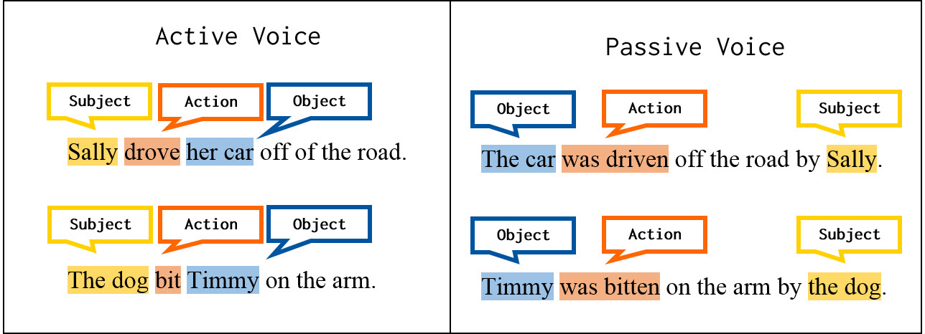
Us Active Voice, not passive

Slide 32

Reference – Harvard style
To give credit to the original author of the information.
It helps other people who are interested in the topic to do research.
To avoid plagiarism.

Slide 33
Basics to include when referencing
Reference List
In-text
Author’s surname and initials
Year of publication
title of journal article or chapter in a book
Title of book/journal in italics
Place of publication (City) for books
Name of publisher for books
Volume and edition number if available
Page numbers where article/chapter appears
Author surname/s
Year
Page number

Slide 34
Book references
Source | In-text | Reference List
One author | Chase (1979: page) (Chase, 1979: page) | Chase, J. 1979. Advertising in the modern world. New York: Simon & Schuster.
Two authors | Ellis and Peters (2000: page) (Ellis & Peters, 2000: page) | Ellis, R. & Peters, J.P. 2000. Writing about literature. London: Macmillian.
Three or more authors | Henderson et al. (1987: page) (Henderson et al., 1987: page) | Henderson, R.S., Smith, P.G., Rossiter, I. & King, P.Q. 1987. The tenets of moral philosophy. New York: Van Nostrand.

Slide 35
Journal articles
Source | In-text | Reference List
Indication of volume, issue, pp, date | Kruger (1988: page) (Kruger, 1988: page) | Kruger, J.P. 1988. Sexism in advertising. Communicare, 7(3):12-15, March 11.
Indication of vol, pp and season: | Lee (1986: page) (Lee, 1986: page) | Lee, S.T. 1986. The semantics of advertising. Psychology Today, 19:34-37, Fall.
Electronic journals | Davids and Du Toit (2005) (Davids & Du Toit, 2005) | Jones, F., Davids, C. & Du Toit, A. 2005. Analysis of the citation of web-based information resources by Unisa academic researchers. South African Journal of Information Management, 7(3). http://general.rau.ac.za/infosci/raujournal [16 November 2005].

Slide 36
Further hints on referencing
Pay attention to spacing – ONE space after each punctuation mark.
The titles of books and the titles of journals are always in italics (but NOT the title of journal articles/chapters in books).
Do not justify the right margin in the reference list – if you do, you will get unnecessary “white space” between items, especially when citing websites.
DO NOT number the reference list, always list it alphabetically according to the authors’ surnames.
Indent the second line (and third etc.) of each reference in your reference list

Slide 37
